Slide 1
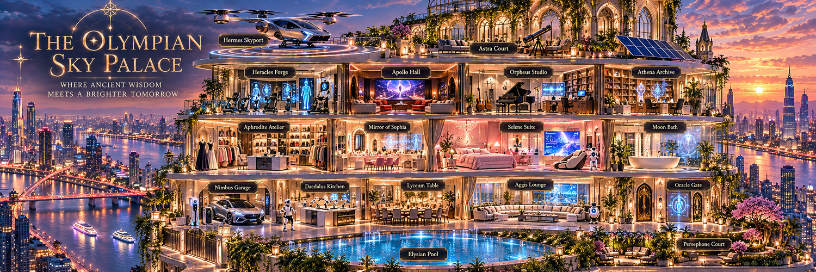
THE OLYMPIAN SKY PALACE
DREAMY ARCHITECTURE · THOUGHTFUL INTELLIGENCE · ROBOTICS · SOLAR
A FAIRYTALE HOME, INTELLIGENTLY IMAGINED
A speculative luxury penthouse concept overlooking a vibrant river metropolis
Notes:
Welcome to The Olympian Sky Palace, a speculative architectural concept that blends the atmosphere of a magical academy and classical mythology with emerging smart-home technology. This presentation tours every programmed space, explains the material language, and shows how AI, robotics, and solar generation would support daily life. The images are concept illustrations, not technical construction drawings.

Slide 2
✧ THE OLYMPIAN SKY PALACE
DESIGN VISION
A castle in the clouds. A home in the future.
A river-facing penthouse that balances enchantment, comfort and real technological purpose.
01
MYTHIC ARCHITECTURE
02
INVISIBLE INTELLIGENCE
Gothic arches, celestial motifs, glowing stone and layered courtyards create a sense of wonder.
AI appears as useful displays, meaningful automations and optional assistants—not decorative jargon.
03
HUMAN-CENTERED LUXURY
04
LOWER-IMPACT LIVING
A library for reading, a studio for music, a true dressing room and a peaceful bedroom.
Rooftop photovoltaics, energy orchestration and water-aware systems support efficiency.
THE PRINCESS EDITION • AI + ROBOTICS + SOLAR
02 / 27
Notes:
The concept is built on four ideas. First, the architecture must feel distinctive even without its technology: pointed arches, luminous vaults and celestial ornament bring a magical-academy atmosphere. Second, AI must deliver specific value through displays and automation while remaining unobtrusive. Third, each space is planned for its real activity, from recording music to storing delicate garments. Finally, rooftop solar and energy-aware operation help the design think beyond appearance.

Slide 3
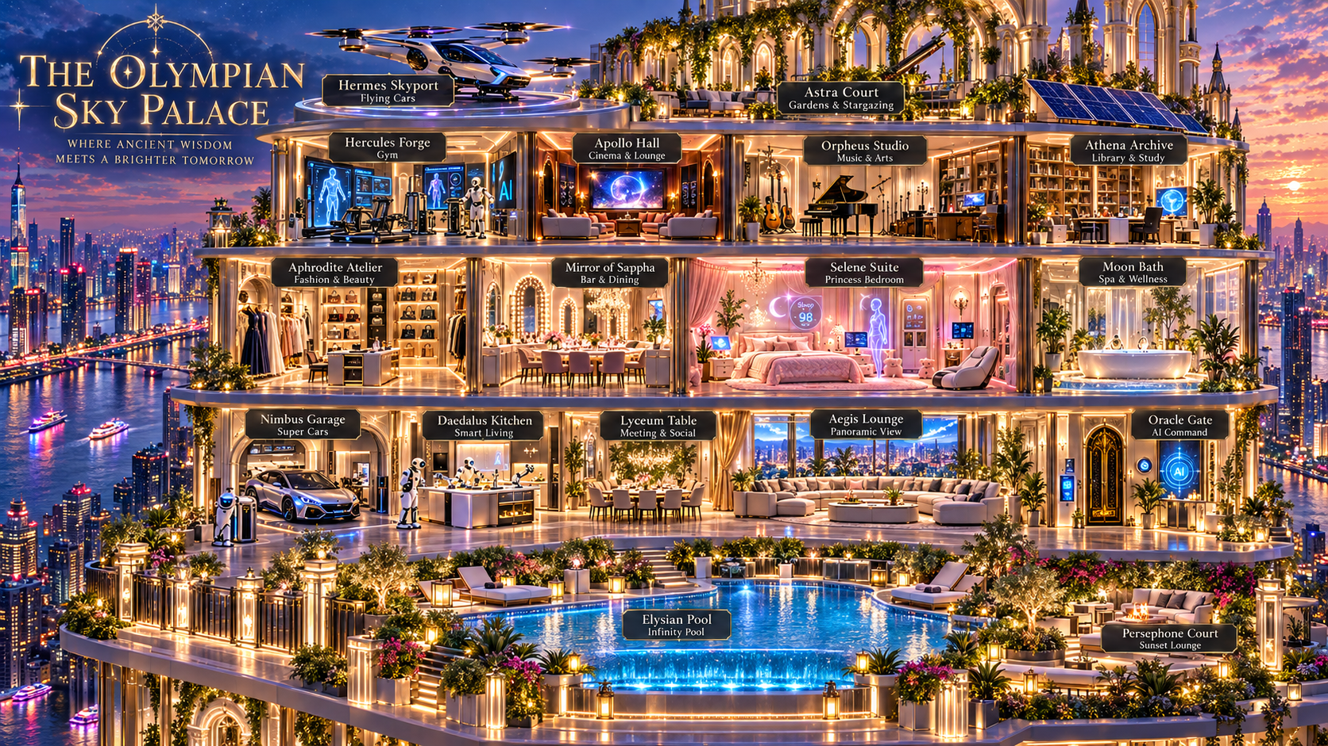
✧ THE OLYMPIAN SKY PALACE
MASTERPLAN
Four levels, one connected story
17 named destinations are arranged for intuitive privacy, sound separation and views.
ROOF
Mobility + skyline
Hermes Skyport · Astra Court
CREATIVE
Body + imagination
Heracles · Apollo · Orpheus · Athena
PRIVATE
Beauty + rest
Aphrodite · Sophia · Selene · Moon
SOCIAL
Connection + living
Nimbus · Daedalus · Lyceum · Aegis · Oracle
OUTDOOR
Nature + renewal
Elysian · Persephone
THE PRINCESS EDITION • AI + ROBOTICS + SOLAR
03 / 27
Notes:
The architecture is organized as a vertical sequence of moods. At the roof, transportation and stargazing occupy the open skyline. The creative level holds exercise, entertainment, music and serious study. The private level groups fashion, beauty, sleep and bathing to shorten daily routines. The social level links arrival, kitchen, dining and lounge. Finally, the pool and gardens offer an outdoor escape. The spatial diagram is conceptual; circulation, fire separation, acoustics and structural spans must be developed in a real building study.

Slide 4
✧ THE OLYMPIAN SKY PALACE
ARCHITECTURE
A visual language of ancient myth + future craft
Ornament is meaningful; technology is integrated into the architecture.
GOTHIC RHYTHM
COUTURE WARMTH
Pointed arches, vertical piers, star motifs and repeating tracery.
Ivory lacquer, champagne brass, blush velvet and fluted finishes.
THE CITY AS ART
LUMINOUS TECHNOLOGY
High-performance panoramic glazing frames the river and urban lights.
Holographic interfaces, glass displays and robots sit within a timeless shell.
THE PRINCESS EDITION • AI + ROBOTICS + SOLAR
04 / 27
Notes:
The palace sits between old-world scholarship and advanced digital living. Gothic rhythm gives it a recognizable silhouette. Couture warmth makes the interiors inviting rather than clinical. The river city must remain visible through large spans of high-performing glass. Finally, screens and robotics should be visually integrated into the walls, furniture and lighting rather than accumulating as consumer gadgets. Avoid too many ornaments; the most luxurious gesture is often space, light and proportion.

Slide 5
✧ THE OLYMPIAN SKY PALACE
SMART-HOME ARCHITECTURE
AI should make itself useful—and optional
A unified technology layer is shared across rooms, with local controls and clear boundaries.
01
02
03
04
SENSE
UNDERSTAND
COORDINATE
EXPLAIN
Occupancy, daylight, temperature, humidity, water and energy meters.
Opt-in routines, schedules and context with privacy limits.
Lighting, climate, shades, AV, charging and noncritical robot tasks.
Readable room dashboards, status alerts and physical override controls.
CORE DESIGN PRINCIPLE
Reliable manual controls • Consent-based sensing • Local-first routines • Safe offline operation
THE PRINCESS EDITION • AI + ROBOTICS + SOLAR
05 / 27
Notes:
Think of the home as a layered system. Sensors describe useful conditions, such as light, temperature and energy flow. A household-configured orchestration layer translates those inputs into understandable actions. Screens tell occupants what is happening; every high-impact function still has a reliable local method. Private data should not be collected merely because it can be. User choice, transparency, offline resilience and security are foundational design requirements.

Slide 6
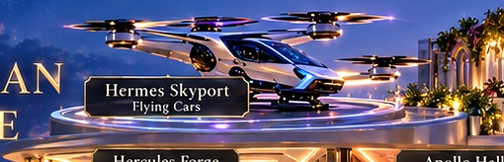
✧ THE OLYMPIAN SKY PALACE
ROOFTOP / 01 / MOBILITY
Hermes Skyport
The ritual of arrival, reimagined
SPATIAL DESIGN
• Circular landing deck with illuminated perimeter and discreet wind screens.
• Gothic colonnades create a ceremonial arrival against the river skyline.
EQUIPMENT & FIT-OUT
• eVTOL landing zone concept and protected passenger route
• Charging interface, weather beacon and fire-safety provisions
NAME & INSPIRATION
Hermes · messenger of the gods
AI & ROBOTICS
A future-facing arrival framed by the silhouette of a magical academy.
• AI-assisted weather, occupancy and landing status displays
• Automated lighting, access control and ground-crew alerts
01 / MOBILITY / ROOFTOP
THE PRINCESS EDITION • AI + ROBOTICS + SOLAR
06 / 27
Notes:
Hermes Skyport is inspired by Hermes · messenger of the gods. The ritual of arrival, reimagined. Architectural strategy: Circular landing deck with illuminated perimeter and discreet wind screens. Gothic colonnades create a ceremonial arrival against the river skyline. Proposed equipment includes eVTOL landing zone concept and protected passenger route Charging interface, weather beacon and fire-safety provisions The visible intelligence layer would provide AI-assisted weather, occupancy and landing status displays Automated lighting, access control and ground-crew alerts The skyport is a design aspiration, not a ready-to-build helipad. Its viability requires independent structural engineering, aircraft-operator approval, aviation authority review, fire protection planning, and acoustic assessment. The ambition is to make advanced mobility feel seamless rather than intrusive. The defining emotional experience is: A future-facing arrival framed by the silhouette of a magical academy.

Slide 7
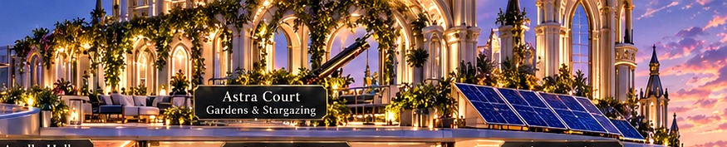
✧ THE OLYMPIAN SKY PALACE
ROOFTOP / 02 / SKY GARDEN
Astra Court
The observatory above the city
SPATIAL DESIGN
• Open-air terrace with slender Gothic arches, warm stone and calm seating.
• Long river-facing sightlines, telescope alcove and low-profile planters.
EQUIPMENT & FIT-OUT
• Astronomical telescope and motorized shade canopy
• Solar pergola, weatherproof lounge furniture and ambient lighting
NAME & INSPIRATION
Astra · the stars
AI & ROBOTICS
A quiet perch to watch the city glow and the sky slowly darken.
• Weather-reactive shades and intelligent irrigation
• Stargazing presets and adaptive light-pollution control
02 / SKY GARDEN / ROOFTOP
THE PRINCESS EDITION • AI + ROBOTICS + SOLAR
07 / 27
Notes:
Astra Court is inspired by Astra · the stars. The observatory above the city. Architectural strategy: Open-air terrace with slender Gothic arches, warm stone and calm seating. Long river-facing sightlines, telescope alcove and low-profile planters. Proposed equipment includes Astronomical telescope and motorized shade canopy Solar pergola, weatherproof lounge furniture and ambient lighting The visible intelligence layer would provide Weather-reactive shades and intelligent irrigation Stargazing presets and adaptive light-pollution control The garden should remain visually light so that the river panorama is never blocked. Solar panels can become an architectural feature rather than an add-on. Lighting scenes balance atmosphere with dark-sky awareness, while weather-aware controls protect furniture and planting. The defining emotional experience is: A quiet perch to watch the city glow and the sky slowly darken.

Slide 8
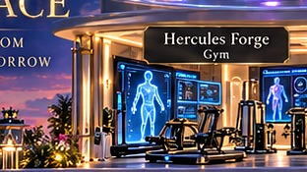
✧ THE OLYMPIAN SKY PALACE
CREATIVE LEVEL / 03 / FITNESS
Heracles Forge
Strength guided by intelligence
SPATIAL DESIGN
• Glass-fronted performance studio with metallic details and acoustic flooring.
• An illuminated smart wall makes coaching visibly part of the architecture.
EQUIPMENT & FIT-OUT
• Connected treadmill, rowing machine and adjustable resistance station
• Functional training kit, stretch area and secure equipment storage
NAME & INSPIRATION
Heracles · strength and endurance
AI & ROBOTICS
Training that feels personal, motivational and visually futuristic.
• Large AI fitness-coach display with form-tracking visualization
• Optional wearable integration, workout plans and recovery prompts
03 / FITNESS / CREATIVE LEVEL
THE PRINCESS EDITION • AI + ROBOTICS + SOLAR
08 / 27
Notes:
Heracles Forge is inspired by Heracles · strength and endurance. Strength guided by intelligence. Architectural strategy: Glass-fronted performance studio with metallic details and acoustic flooring. An illuminated smart wall makes coaching visibly part of the architecture. Proposed equipment includes Connected treadmill, rowing machine and adjustable resistance station Functional training kit, stretch area and secure equipment storage The visible intelligence layer would provide Large AI fitness-coach display with form-tracking visualization Optional wearable integration, workout plans and recovery prompts AI feedback here is an opt-in wellness experience rather than medical diagnosis. A large interactive screen shows movement guides and training progress. A safe circulation zone and impact-resistant flooring make the space functional; privacy settings allow all cameras and tracking to be disabled. The defining emotional experience is: Training that feels personal, motivational and visually futuristic.

Slide 9
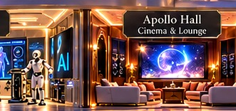
✧ THE OLYMPIAN SKY PALACE
CREATIVE LEVEL / 04 / CINEMA
Apollo Hall
A private stage for stories and sound
SPATIAL DESIGN
• Moody theater with stepped acoustic wall panels and sculptural lighting.
• A comfortable lounge remains suitable for both movies and karaoke.
EQUIPMENT & FIT-OUT
• Ultra-high-definition projection or large premium display
• Surround sound, wireless microphones and acoustic treatments
NAME & INSPIRATION
Apollo · music, light and the arts
AI & ROBOTICS
One room becomes a cinema, stage or gaming lounge with a tap.
• Scene-based AV orchestration for film, karaoke and gaming
• Adaptive sound profiles, lighting cues and voice navigation
04 / CINEMA / CREATIVE LEVEL
THE PRINCESS EDITION • AI + ROBOTICS + SOLAR
09 / 27
Notes:
Apollo Hall is inspired by Apollo · music, light and the arts. A private stage for stories and sound. Architectural strategy: Moody theater with stepped acoustic wall panels and sculptural lighting. A comfortable lounge remains suitable for both movies and karaoke. Proposed equipment includes Ultra-high-definition projection or large premium display Surround sound, wireless microphones and acoustic treatments The visible intelligence layer would provide Scene-based AV orchestration for film, karaoke and gaming Adaptive sound profiles, lighting cues and voice navigation The room should be acoustically isolated from the bedroom floor. A dual-mode setup preserves cinema fidelity while allowing a lively karaoke session. The acoustic system should provide speech clarity, careful bass containment and straightforward manual control in case any smart subsystem is unavailable. The defining emotional experience is: One room becomes a cinema, stage or gaming lounge with a tap.

Slide 10
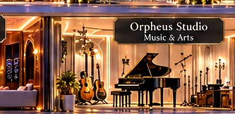
✧ THE OLYMPIAN SKY PALACE
CREATIVE LEVEL / 05 / MUSIC
Orpheus Studio
Create music with a modern muse
SPATIAL DESIGN
• Warm walnut surfaces, fabric acoustic panels and a dramatic arched window.
• An intimate creative room centered around a grand piano.
EQUIPMENT & FIT-OUT
• Grand piano, guitars, studio monitors and microphones
• Audio interface, digital mixing console and recording computer
NAME & INSPIRATION
Orpheus · legendary musician and poet
AI & ROBOTICS
A real instrument-first music studio with computation in the background.
• AI-supported composition, arrangement and transcription workflow
• Smart acoustic presets, instrument routing and lighting scenes
05 / MUSIC / CREATIVE LEVEL
THE PRINCESS EDITION • AI + ROBOTICS + SOLAR
10 / 27
Notes:
Orpheus Studio is inspired by Orpheus · legendary musician and poet. Create music with a modern muse. Architectural strategy: Warm walnut surfaces, fabric acoustic panels and a dramatic arched window. An intimate creative room centered around a grand piano. Proposed equipment includes Grand piano, guitars, studio monitors and microphones Audio interface, digital mixing console and recording computer The visible intelligence layer would provide AI-supported composition, arrangement and transcription workflow Smart acoustic presets, instrument routing and lighting scenes Sound isolation is critical: the piano and monitoring speakers need an acoustically treated shell independent of surrounding structure where feasible. AI software can help with idea generation, transcription and mixing assistance, while final artistic decisions stay with the musician. Camera and microphones should have physical privacy controls. The defining emotional experience is: A real instrument-first music studio with computation in the background.

Slide 11

✧ THE OLYMPIAN SKY PALACE
CREATIVE LEVEL / 06 / WORK & READING
Athena Archive
A place to think beyond the horizon
SPATIAL DESIGN
• Double-height book wall, bronze reading lamps and quiet upholstered chairs.
• A generous desk faces the metropolis without screen glare.
EQUIPMENT & FIT-OUT
• Ergonomic work desk, high-resolution displays and adjustable lighting
• Curated bookcases, reading nook, secure filing and video-call kit
NAME & INSPIRATION
Athena · wisdom and strategy
AI & ROBOTICS
A library with the soul of an old university and the tools of tomorrow.
• Research assistant interface and searchable personal knowledge library
• Noise-aware focus mode, calendar cues and task scene automation
06 / WORK & READING / CREATIVE LEVEL
THE PRINCESS EDITION • AI + ROBOTICS + SOLAR
11 / 27
Notes:
Athena Archive is inspired by Athena · wisdom and strategy. A place to think beyond the horizon. Architectural strategy: Double-height book wall, bronze reading lamps and quiet upholstered chairs. A generous desk faces the metropolis without screen glare. Proposed equipment includes Ergonomic work desk, high-resolution displays and adjustable lighting Curated bookcases, reading nook, secure filing and video-call kit The visible intelligence layer would provide Research assistant interface and searchable personal knowledge library Noise-aware focus mode, calendar cues and task scene automation This is deliberately a real library, not simply another screen room. Books, daylight, comfort and focus remain the priorities. AI appears in discreet research displays and workflow automation, with clear source attribution and a device-free reading setting. High-performing glazing is important for both skyline views and thermal control. The defining emotional experience is: A library with the soul of an old university and the tools of tomorrow.

Slide 12

✧ THE OLYMPIAN SKY PALACE
PRIVATE LEVEL / 07 / FASHION
Aphrodite Atelier
An intimate couture gallery
SPATIAL DESIGN
• Parisian haute-couture language: cream lacquer, cane motifs and champagne metal.
• Gallery-like display bays for garments, shoes, handbags and accessories.
EQUIPMENT & FIT-OUT
• Illuminated full-height wardrobes, specialized handbag shelving
• Pull-out shoe display, jewelry trays and a dressing island
NAME & INSPIRATION
Aphrodite · beauty and refinement
AI & ROBOTICS
A boutique-inspired wardrobe, elegant without relying on any logo.
• Wardrobe catalog and outfit coordination on a discreet mirror display
• Smart textile lighting, humidity monitoring and inventory reminders
07 / FASHION / PRIVATE LEVEL
THE PRINCESS EDITION • AI + ROBOTICS + SOLAR
12 / 27
Notes:
Aphrodite Atelier is inspired by Aphrodite · beauty and refinement. An intimate couture gallery. Architectural strategy: Parisian haute-couture language: cream lacquer, cane motifs and champagne metal. Gallery-like display bays for garments, shoes, handbags and accessories. Proposed equipment includes Illuminated full-height wardrobes, specialized handbag shelving Pull-out shoe display, jewelry trays and a dressing island The visible intelligence layer would provide Wardrobe catalog and outfit coordination on a discreet mirror display Smart textile lighting, humidity monitoring and inventory reminders The design draws on timeless Parisian couture boutique aesthetics rather than reproducing a house identity. Storage is organized around gentle fabric care, accessible visibility and varied item sizes. Adjustable warm-to-neutral illumination supports outfit evaluation without overwhelming the luxurious material palette. The defining emotional experience is: A boutique-inspired wardrobe, elegant without relying on any logo.

Slide 13
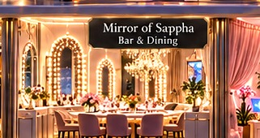
✧ THE OLYMPIAN SKY PALACE
PRIVATE LEVEL / 08 / BEAUTY
Mirror of Sophia
Where style meets self-expression
SPATIAL DESIGN
• Soft pink and ivory vanity salon with fluted details and mirrored arches.
• Gentle diffused lighting avoids harsh shadows and cluttered counters.
EQUIPMENT & FIT-OUT
• Height-adjustable vanity, organized cosmetic drawers and seating
• Color-accurate mirrors, task lighting and integrated charging
NAME & INSPIRATION
Sophia · the Greek ideal of wisdom
AI & ROBOTICS
A playful, polished getting-ready experience that remains personal.
• Opt-in digital styling previews and outfit pairing recommendations
• Configurable vanity scenes and product organization support
08 / BEAUTY / PRIVATE LEVEL
THE PRINCESS EDITION • AI + ROBOTICS + SOLAR
13 / 27
Notes:
Mirror of Sophia is inspired by Sophia · the Greek ideal of wisdom. Where style meets self-expression. Architectural strategy: Soft pink and ivory vanity salon with fluted details and mirrored arches. Gentle diffused lighting avoids harsh shadows and cluttered counters. Proposed equipment includes Height-adjustable vanity, organized cosmetic drawers and seating Color-accurate mirrors, task lighting and integrated charging The visible intelligence layer would provide Opt-in digital styling previews and outfit pairing recommendations Configurable vanity scenes and product organization support Digital styling tools are optional aids, not standards for appearance. Neutral, color-accurate lighting helps make practical choices, while the surrounding pink and champagne finishes contribute atmosphere. The room pairs naturally with the Atelier through a short, comfortable circulation route. The defining emotional experience is: A playful, polished getting-ready experience that remains personal.

Slide 14
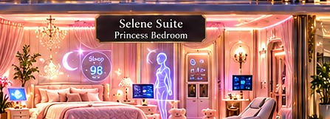
✧ THE OLYMPIAN SKY PALACE
PRIVATE LEVEL / 09 / BEDROOM
Selene Suite
The princess bedroom, with a calm intelligence
SPATIAL DESIGN
• Canopy-inspired headboard, blush silk textures and moonlit wall details.
• A small built-in wardrobe and private reading corner are part of the suite.
EQUIPMENT & FIT-OUT
• Premium bed, compact wardrobe and personal bedside console
• Massage chair, soundscape speakers and motorized blackout drapes
NAME & INSPIRATION
Selene · goddess of the moon
AI & ROBOTICS
A princess suite that feels magical while prioritizing rest and comfort.
• Visible bedside AI sleep-and-comfort dashboard
• Circadian lighting, climate scenes and optional sleep-environment sensing
09 / BEDROOM / PRIVATE LEVEL
THE PRINCESS EDITION • AI + ROBOTICS + SOLAR
14 / 27
Notes:
Selene Suite is inspired by Selene · goddess of the moon. The princess bedroom, with a calm intelligence. Architectural strategy: Canopy-inspired headboard, blush silk textures and moonlit wall details. A small built-in wardrobe and private reading corner are part of the suite. Proposed equipment includes Premium bed, compact wardrobe and personal bedside console Massage chair, soundscape speakers and motorized blackout drapes The visible intelligence layer would provide Visible bedside AI sleep-and-comfort dashboard Circadian lighting, climate scenes and optional sleep-environment sensing The small wardrobe and massage chair are explicitly included in this suite rather than moved to the main Atelier. A glowing but dimmable dashboard displays room temperature, light scenes and sleep preferences. Sleep sensing should remain optional, local-first where possible, and non-medical. Night mode must suppress bright screens and notifications. The defining emotional experience is: A princess suite that feels magical while prioritizing rest and comfort.

Slide 15
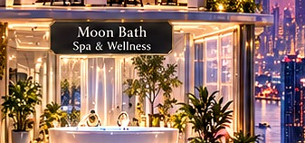
✧ THE OLYMPIAN SKY PALACE
PRIVATE LEVEL / 10 / SPA
Moon Bath
A private ritual of restoration
SPATIAL DESIGN
• Freestanding soaking tub, pale stone slabs and softly glowing niches.
• Privacy glass and arched reflections connect the room to the skyline.
EQUIPMENT & FIT-OUT
• Smart soaking tub, rainfall shower and heated towel cabinet
• Humidity-resistant speakers, radiant floor and anti-slip surfaces
NAME & INSPIRATION
Lunar reflection · stillness and renewal
AI & ROBOTICS
A luminous sanctuary with practical comfort hidden behind the magic.
• Preset water-temperature controls and energy-aware bath filling
• Humidity extraction, leak monitoring and low-light night guidance
10 / SPA / PRIVATE LEVEL
THE PRINCESS EDITION • AI + ROBOTICS + SOLAR
15 / 27
Notes:
Moon Bath is inspired by Lunar reflection · stillness and renewal. A private ritual of restoration. Architectural strategy: Freestanding soaking tub, pale stone slabs and softly glowing niches. Privacy glass and arched reflections connect the room to the skyline. Proposed equipment includes Smart soaking tub, rainfall shower and heated towel cabinet Humidity-resistant speakers, radiant floor and anti-slip surfaces The visible intelligence layer would provide Preset water-temperature controls and energy-aware bath filling Humidity extraction, leak monitoring and low-light night guidance Because the bathroom is wet and humid, safety and maintenance matter as much as its visual mood. Use certified protected electrical zones, slip-resistant surfaces and sensors for leaks, humidity and water temperature. Smart controls must always offer tactile manual override. The defining emotional experience is: A luminous sanctuary with practical comfort hidden behind the magic.

Slide 16
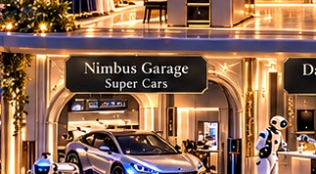
✧ THE OLYMPIAN SKY PALACE
SOCIAL LEVEL / 11 / MOBILITY
Nimbus Garage
The quietly electric arrival floor
SPATIAL DESIGN
• A sculptural vehicle bay with museum-like linear lighting.
• Stone walls and hidden storage give the garage a gallery aesthetic.
EQUIPMENT & FIT-OUT
• Premium electric vehicle charger and cable-management arm
• Vehicle-care cabinet, ventilation and fire safety provisions
NAME & INSPIRATION
Nimbus · cloud and atmosphere
AI & ROBOTICS
A garage that celebrates design without sacrificing safety.
• Dynamic charging coordination with solar and battery supply
• Vehicle status monitor, access control and charging notifications
11 / MOBILITY / SOCIAL LEVEL
THE PRINCESS EDITION • AI + ROBOTICS + SOLAR
16 / 27
Notes:
Nimbus Garage is inspired by Nimbus · cloud and atmosphere. The quietly electric arrival floor. Architectural strategy: A sculptural vehicle bay with museum-like linear lighting. Stone walls and hidden storage give the garage a gallery aesthetic. Proposed equipment includes Premium electric vehicle charger and cable-management arm Vehicle-care cabinet, ventilation and fire safety provisions The visible intelligence layer would provide Dynamic charging coordination with solar and battery supply Vehicle status monitor, access control and charging notifications Charging and garage fire-safety design should be professionally engineered. The vehicle shown represents a design direction, not a committed model. AI scheduling can shift nonessential charging to energy-favorable periods, but critical safety systems remain independent of decorative automation. The defining emotional experience is: A garage that celebrates design without sacrificing safety.

Slide 17
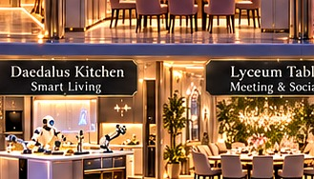
✧ THE OLYMPIAN SKY PALACE
SOCIAL LEVEL / 12 / CULINARY
Daedalus Kitchen
The craftsman’s kitchen, reinvented
SPATIAL DESIGN
• Warm marble island, integrated appliances and bronze-accent shelving.
• Unobstructed preparation zones keep a visually rich kitchen functional.
EQUIPMENT & FIT-OUT
• Induction range, combination oven, refrigerator and dishwasher
• Countertop preparation devices, pantry storage and extraction hood
NAME & INSPIRATION
Daedalus · master inventor and builder
AI & ROBOTICS
Cooking remains human and creative, with intelligent assistance nearby.
• Robot-assisted food prep demonstrations with supervised operation
• Recipe guidance, inventory suggestions and energy-aware scheduling
12 / CULINARY / SOCIAL LEVEL
THE PRINCESS EDITION • AI + ROBOTICS + SOLAR
17 / 27
Notes:
Daedalus Kitchen is inspired by Daedalus · master inventor and builder. The craftsman’s kitchen, reinvented. Architectural strategy: Warm marble island, integrated appliances and bronze-accent shelving. Unobstructed preparation zones keep a visually rich kitchen functional. Proposed equipment includes Induction range, combination oven, refrigerator and dishwasher Countertop preparation devices, pantry storage and extraction hood The visible intelligence layer would provide Robot-assisted food prep demonstrations with supervised operation Recipe guidance, inventory suggestions and energy-aware scheduling Kitchen robotics should be designed around meaningful and safe tasks such as ingredient delivery, monitored preparation or cleaning assistance. Human supervision, interlocks and emergency stops are non-negotiable. The smart display is easy to view but outside major spill and heat zones. The defining emotional experience is: Cooking remains human and creative, with intelligent assistance nearby.

Slide 18
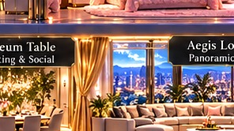
✧ THE OLYMPIAN SKY PALACE
SOCIAL LEVEL / 13 / DINING
Lyceum Table
A gathering place for ideas and taste
SPATIAL DESIGN
• A sculptural long table beneath a restrained contemporary chandelier.
• Gothic windows and warm textiles create a welcoming social scale.
EQUIPMENT & FIT-OUT
• Expandable dining table, comfortable upholstered chairs
• Concealed serving storage and layered scene lighting
NAME & INSPIRATION
Lyceum · Aristotle’s school of thought
AI & ROBOTICS
A conversation-centered room, inspired by the ancient exchange of ideas.
• Dinner scene orchestration for light, sound and climate
• Meal timing prompts and integration with kitchen service
13 / DINING / SOCIAL LEVEL
THE PRINCESS EDITION • AI + ROBOTICS + SOLAR
18 / 27
Notes:
Lyceum Table is inspired by Lyceum · Aristotle’s school of thought. A gathering place for ideas and taste. Architectural strategy: A sculptural long table beneath a restrained contemporary chandelier. Gothic windows and warm textiles create a welcoming social scale. Proposed equipment includes Expandable dining table, comfortable upholstered chairs Concealed serving storage and layered scene lighting The visible intelligence layer would provide Dinner scene orchestration for light, sound and climate Meal timing prompts and integration with kitchen service The dining room should feel equally natural for everyday family meals and a formal gathering. Controls are primarily ambient—lighting, sound and temperature—rather than demanding attention. Natural acoustics matter, so soft surfaces should moderate reverberation. The defining emotional experience is: A conversation-centered room, inspired by the ancient exchange of ideas.

Slide 19
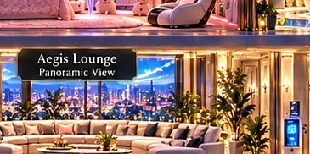
✧ THE OLYMPIAN SKY PALACE
SOCIAL LEVEL / 14 / LIVING
Aegis Lounge
The shielded heart of the home
SPATIAL DESIGN
• Expansive glazing, sculptural sofa and a framed cinematic smart display.
• Soft layered textiles contrast with architectural stone and metal.
EQUIPMENT & FIT-OUT
• Premium display, immersive audio and comfortable modular seating
• Ambient light strips, discreet table charging and smart blinds
NAME & INSPIRATION
Aegis · a symbol of protection
AI & ROBOTICS
The social heart of the palace, with control that never dominates.
• Whole-home command access from a subtle central interface
• Context-aware entertainment and climate scenes
14 / LIVING / SOCIAL LEVEL
THE PRINCESS EDITION • AI + ROBOTICS + SOLAR
19 / 27
Notes:
Aegis Lounge is inspired by Aegis · a symbol of protection. The shielded heart of the home. Architectural strategy: Expansive glazing, sculptural sofa and a framed cinematic smart display. Soft layered textiles contrast with architectural stone and metal. Proposed equipment includes Premium display, immersive audio and comfortable modular seating Ambient light strips, discreet table charging and smart blinds The visible intelligence layer would provide Whole-home command access from a subtle central interface Context-aware entertainment and climate scenes Aegis connects mythological protection with comfort and an unobtrusive central home interface. The default visual state can be art rather than dashboards. Guests should be able to use lighting and entertainment intuitively without becoming users of the home’s technical system. The defining emotional experience is: The social heart of the palace, with control that never dominates.

Slide 20

✧ THE OLYMPIAN SKY PALACE
SOCIAL LEVEL / 15 / ARRIVAL
Oracle Gate
A ceremonial entrance with modern awareness
SPATIAL DESIGN
• A tall pointed arch, filigree doors and a dramatic warm welcome light.
• Security equipment is integrated into crafted architectural elements.
EQUIPMENT & FIT-OUT
• Secure smart lock, video intercom and entryway parcel storage
• Entry lighting, access keypad and emergency mechanical egress
NAME & INSPIRATION
Oracle · foresight and guidance
AI & ROBOTICS
A dramatic threshold that feels both welcoming and secure.
• Consent-based visitor notification and anomaly detection
• Arrival scenes for climate, lights and preferred soundtrack
15 / ARRIVAL / SOCIAL LEVEL
THE PRINCESS EDITION • AI + ROBOTICS + SOLAR
20 / 27
Notes:
Oracle Gate is inspired by Oracle · foresight and guidance. A ceremonial entrance with modern awareness. Architectural strategy: A tall pointed arch, filigree doors and a dramatic warm welcome light. Security equipment is integrated into crafted architectural elements. Proposed equipment includes Secure smart lock, video intercom and entryway parcel storage Entry lighting, access keypad and emergency mechanical egress The visible intelligence layer would provide Consent-based visitor notification and anomaly detection Arrival scenes for climate, lights and preferred soundtrack Robust manual egress and offline entry options should remain available. Facial recognition, if used at all, requires explicit household choice, good legal review and an alternative method. Important security events should be clearly displayed, without making the entrance feel like a surveillance checkpoint. The defining emotional experience is: A dramatic threshold that feels both welcoming and secure.

Slide 21
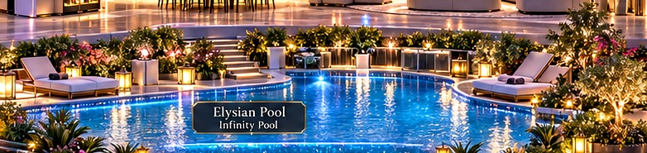
✧ THE OLYMPIAN SKY PALACE
OUTDOOR LEVEL / 16 / WATER
Elysian Pool
An infinite horizon of calm
SPATIAL DESIGN
• Infinity edge aligned with the river skyline and understated planting.
• No distracting statues: water, stone and light provide the visual identity.
EQUIPMENT & FIT-OUT
• Filtration and water-treatment system, underwater LED lights
• Poolside loungers, slip-resistant terrace and safety barriers
NAME & INSPIRATION
Elysium · the realm of serenity
AI & ROBOTICS
The river, the city and the pool become one continuous panorama.
• Water-quality monitoring and pump scheduling
• Leak detection, energy optimization and lighting scenes
16 / WATER / OUTDOOR LEVEL
THE PRINCESS EDITION • AI + ROBOTICS + SOLAR
21 / 27
Notes:
Elysian Pool is inspired by Elysium · the realm of serenity. An infinite horizon of calm. Architectural strategy: Infinity edge aligned with the river skyline and understated planting. No distracting statues: water, stone and light provide the visual identity. Proposed equipment includes Filtration and water-treatment system, underwater LED lights Poolside loungers, slip-resistant terrace and safety barriers The visible intelligence layer would provide Water-quality monitoring and pump scheduling Leak detection, energy optimization and lighting scenes This update intentionally removes awkward ornamental statues. The focus is architectural clarity and the visual line to the river. Pool safety systems, water chemistry and appropriate supervision remain essential; intelligent controls support maintenance but never replace fundamental protections. The defining emotional experience is: The river, the city and the pool become one continuous panorama.

Slide 22
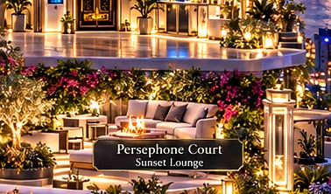
✧ THE OLYMPIAN SKY PALACE
OUTDOOR LEVEL / 17 / GARDEN
Persephone Court
A living garden above the river
SPATIAL DESIGN
• Botanical terrace with graceful arcades and a refined seating grove.
• Seasonal planting softens the futuristic structure and protects privacy.
EQUIPMENT & FIT-OUT
• Planters, shade structure, irrigation and subtle path lighting
• Weather-resistant furnishings and soil care infrastructure
NAME & INSPIRATION
Persephone · seasons and renewal
AI & ROBOTICS
An oasis of softness surrounded by a vibrant urban riverfront.
• Soil-moisture-based watering and plant health reminders
• Adaptive light levels, rain sensing and maintenance scheduling
17 / GARDEN / OUTDOOR LEVEL
THE PRINCESS EDITION • AI + ROBOTICS + SOLAR
22 / 27
Notes:
Persephone Court is inspired by Persephone · seasons and renewal. A living garden above the river. Architectural strategy: Botanical terrace with graceful arcades and a refined seating grove. Seasonal planting softens the futuristic structure and protects privacy. Proposed equipment includes Planters, shade structure, irrigation and subtle path lighting Weather-resistant furnishings and soil care infrastructure The visible intelligence layer would provide Soil-moisture-based watering and plant health reminders Adaptive light levels, rain sensing and maintenance scheduling Select plant species for the local climate, wind exposure and maintenance burden of a high-rise site. Irrigation can draw upon weather and moisture sensors without wasting water. Lighting is low-glare and carefully shielded so the skyline remains the hero. The defining emotional experience is: An oasis of softness surrounded by a vibrant urban riverfront.

Slide 23
✧ THE OLYMPIAN SKY PALACE
EXPERIENCE DESIGN
One day, a hundred thoughtful details
Interconnected spaces respond to routines without demanding constant attention.
07:00
08:15
15:30
19:30
SELENE SUITE
DAEDALUS + LYCEUM
ATHENA + ORPHEUS
APOLLO + ASTRA
Warm light rises gradually; shades open only when requested.
Kitchen suggestions and gentle breakfast lighting.
A quiet focus scene gives way to creative studio work.
Cinema turns into a stargazing evening on the roof.
THE PRINCESS EDITION • AI + ROBOTICS + SOLAR
23 / 27
Notes:
The key to a smart home is continuity across spaces. In the morning, the bedroom gently adjusts light and thermal comfort. At breakfast, the kitchen makes helpful suggestions without taking over. Work and creative pursuits receive different sound and lighting atmospheres. In the evening, entertainment and rooftop relaxation become connected scenes. These are opt-in habits the household can edit or disable. The experience should be graceful even when technology is entirely switched off.

Slide 24
✧ THE OLYMPIAN SKY PALACE
ENERGY ECOSYSTEM
Solar is an architectural system, not an accessory
Manage power flows intelligently while keeping essential systems safe and reliable.
ROOFTOP PV
INVERTER + METER
ENERGY ORCHESTRATOR
STORAGE
HOUSE + EV
›
›
›
›
Roof-integrated modules
Measure generation
Prioritize flexible loads
Optional home battery
Climate, lights, chargers
OPERATING LOGIC
Use solar first where practical • Shift flexible tasks • Track energy • Protect essential loads
THE PRINCESS EDITION • AI + ROBOTICS + SOLAR
24 / 27
Notes:
The solar strategy begins at the roof where photovoltaic modules are part of the architecture. An inverter and metering infrastructure make generation visible. A central energy manager can schedule flexible electricity needs—such as certain charging windows, water heating or noncritical appliances—when supply is favorable. Storage can be considered once actual demand, tariff structures and resilience priorities are known. System size, payback and efficiency cannot be asserted from this concept image and must be developed from a site-specific energy model.

Slide 25
✧ THE OLYMPIAN SKY PALACE
HUMAN-CENTERED TECHNOLOGY
Beautiful technology must also deserve trust
Privacy, physical safety and fallback operation are core design requirements.
CONTROL
PRIVACY
SAFETY
Every important scene is accessible without voice or cloud services.
Mic, camera and wellness sensing can be disabled; access is permissioned.
Emergency egress, electrical protection and fire systems operate independently.
ACCESSIBILITY
MAINTENANCE
HONEST CONCEPT
Readable displays, tactile switches and ergonomic circulation suit varied needs.
Modular systems, replaceable hardware and transparent service logs.
Aviation, solar and structural capabilities require engineering validation.
THE PRINCESS EDITION • AI + ROBOTICS + SOLAR
25 / 27
Notes:
A genuinely intelligent home is not one that records everything or makes every decision automatically. Its technology must be understandable and reliable. Manual controls should always exist for lights, doors and environmental comfort. Microphones, cameras and optional health-adjacent sensors need appropriate notice and consent. Critical life-safety engineering is never left to consumer automation. Finally, because this is a speculative concept, the flying-car platform and solar-energy performance should be treated as goals requiring a proper feasibility study.

Slide 26
✧ THE OLYMPIAN SKY PALACE
FROM DREAM TO DIRECTION
A phased path from concept to buildability
Translate the magical vision into an architectural and engineering program.
I
II
III
IV
V
BRIEF & FEASIBILITY
ARCHITECTURE
SYSTEMS
INTERIORS
COMMISSIONING
Site constraints, skyline views, code, budget, aviation feasibility.
Structure, daylight, acoustics, facade, safe circulation.
Power, PV, charging, cooling, network, water, controls.
Couture fit-out, acoustic rooms, furniture and interfaces.
Test safety, privacy, energy logic and manual fallback.
THE PRINCESS EDITION • AI + ROBOTICS + SOLAR
26 / 27
Notes:
This presentation captures the vision and the functional brief. To move toward a real project, begin with an actual site, desired area, program and budget. Aviation feasibility for a rooftop eVTOL installation is a major threshold. Design engineering then validates structural capacity, fire protection, energy use, water systems, thermal comfort and acoustics. The interiors and software layers can be detailed only after core constraints are understood. A thorough commissioning stage verifies both luxury experiences and safe operation.

Slide 27

THE OLYMPIAN SKY PALACE
A home for imagination. A platform for intelligent living.
ANCIENT WISDOM × FUTURE TECHNOLOGY × HUMAN COMFORT
Notes:
The Olympian Sky Palace is the meeting point of an imagined magical world and an intelligent contemporary home. Each space honors a human activity—thinking, creating, resting, sharing or enjoying nature—while technology supports rather than displaces it. The aim is not simply to show many devices; it is to make life feel more inspiring, comfortable and intentional.

